Slide 2
Dynamic braking in induction motor
Dynamic braking of induction motor is quite different from that of dc motor
If only the supply is disconnected there will be no magnetic field so the induction motor cannot operate as generator.
So there be should be some connection to operate it as a generator

Slide 3
Types of Dynamic braking in induction motor
AC dynamic braking
Self excited braking using capacitor
Dc dynamic braking
Zero sequence braking

Slide 4
AC dynamic braking
The ac dynamic braking is obtained when the motor is run on the single phase supply by disconnecting the one phase from the source and either leaving it open or connecting it with another phase.
The two connections are respectively known as two and three lead connection.
When connected to a 1-phase supply, the motor can be considered to be fed by positive and negative sequence three-phase set of voltages. Net torque produced by the machine is sum of torques due to positive and negative sequence voltages. When rotor has a high resistance, the net torque is negative and braking operation is obtained.
The motor analysis for two lead connection and three lead connection is done as follows:

Slide 5
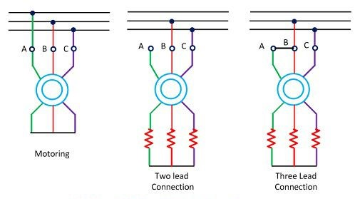

Slide 7
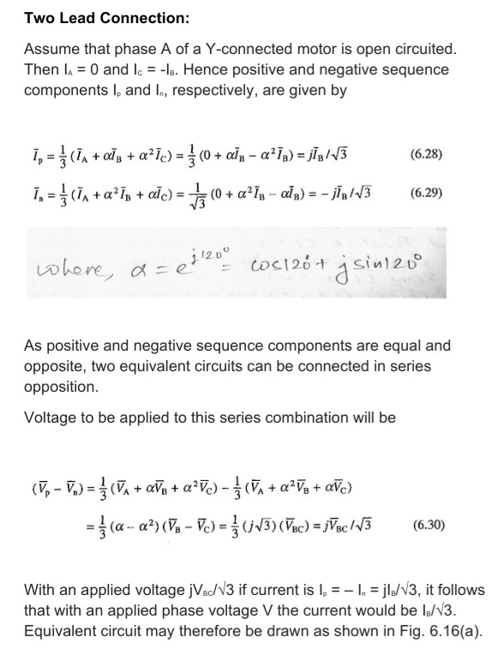

Slide 12
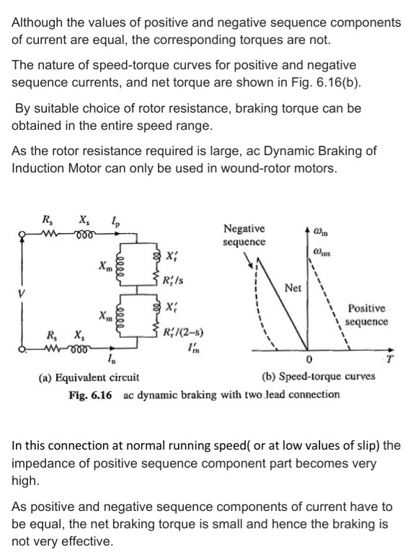

Slide 13
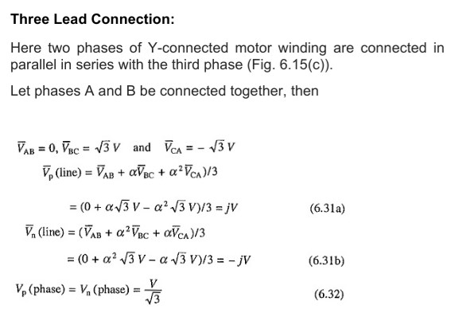

Slide 14
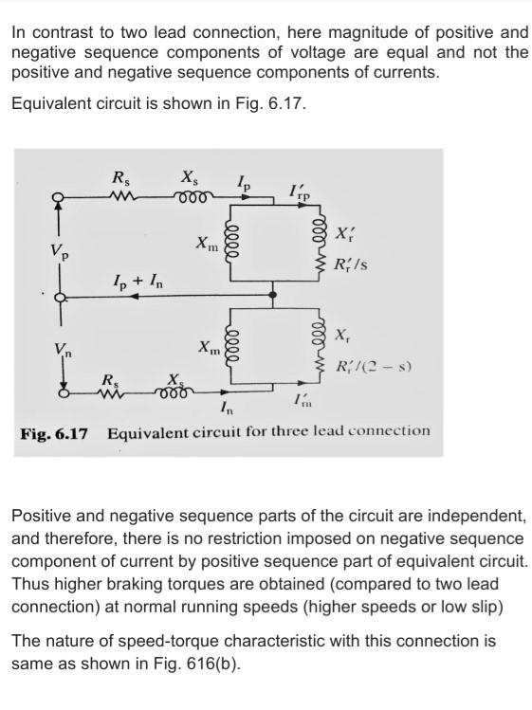

Slide 15
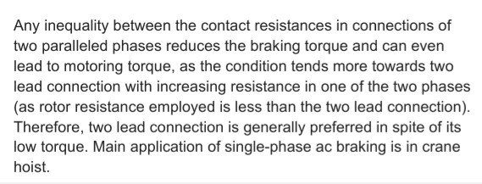

Slide 16
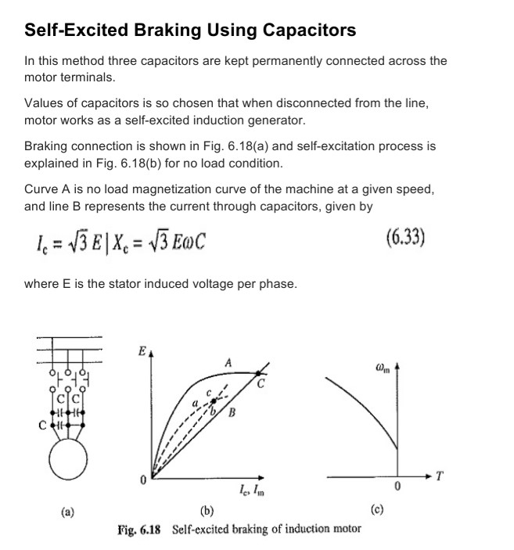

Slide 17
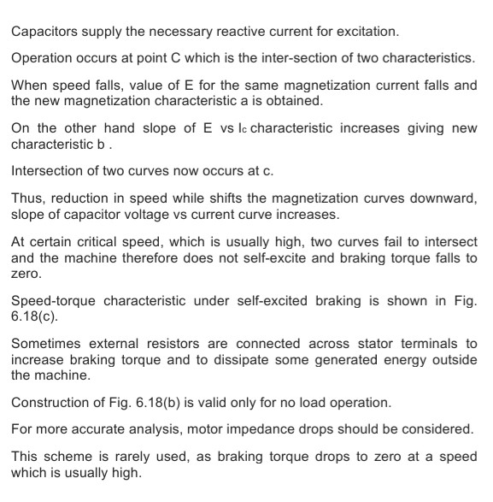

Slide 18
DC dynamic braking

